Slide 1
Distributed Operating Systems
Reference: Chapter 6
Distributed Systems – Concepts and Design 2nd Edition by
George Coulouris, Jean Dallimore, Tim Kindberg

Slide 2
Overview
Introduction
The Kernel
Process and Threads
Naming and Protection
Communication and Invocation
Virtual Memory
Summary

Slide 3
Learning objectives
Know what a modern operating system does to support distributed applications and middleware
  Definition of network OS
  Definition of distributed OS
Understand the relevant abstractions and techniques, focussing on:
  processes, threads, ports and support for invocation mechanisms.
Understand the options for operating system architecture
  monolithic and micro-kernels
*

Slide 4
Introduction
Broad Characterisation of a distributed operating system:
  Its task is to enable a distributed system be conveniently programmed so that it can be used to implement the widest possible range of applications
  It does this by presenting applications with general, problem-oriented abstractions of the resources in a distributed system
  In an open distributed system, the distributed operating system is implemented as a set of kernels and servers (server processes)
Some efforts to design and implement Distributed OSs:
  Mach and Chorus – reached some level of commercial and technical use
  Ameoba, Clouds and V-System – for technical use
Focus here is on the part of a Distributed OS that acts as an infrastructure for general, network-transparent resource management; processors, memory, network interfaces and other peripheral devices.
*

Slide 5
Introduction
A distributed OS must provide facilities for encapsulating resources in a modular and protected fashion while providing the clients with network-wide access to them
Must ensure:
  Encapsulation – useful service interface
  Concurrent Processing -
  Protection
The access by a client to an encapsulated resource is called invocation
Most of the services may be provided by a microkernel;
None but a few research based distributed system can be said to be controlled by a single, homogeneous distributed OS; must currently inter-work with conventional OS kernels such as UNIX
*

Slide 6
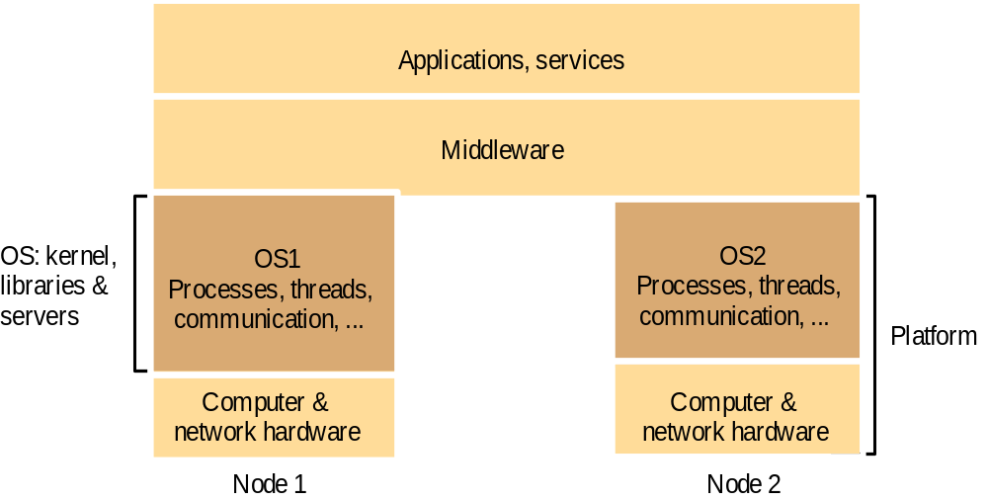
System layers
*
Notes:
Popup: System layers figure from Chapter 2

Slide 7
Middleware and the Operating System
Middleware implements abstractions that support network-wide programming. Examples:
    RPC and RMI (Sun RPC, Corba, Java RMI)
    event distribution and filtering (Corba Event Notification, Elvin)
    resource discovery for mobile computing
    support for multimedia streaming
Traditional OS's (e.g. early Unix, Windows 3.0)
  simplify, protect and optimize the use of local resources
Network OS's (e.g. Mach, modern UNIX, Windows NT)
  do the same but they also support a wide range of communication standards and enable remote processes to access (some) local resources (e.g. files).
*

Slide 8
The support required by middleware and distributed applications
OS manages the basic resources of computer systems:
  processing, memory, persistent storage and communication.
It is the task of an operating system to:
  raise the programming interface for these resources to a more useful level:
    By providing abstractions of the basic resources such as:
    processes, unlimited virtual memory, files, communication channels
    Protection of the resources used by applications
    Concurrent processing to enable applications to complete their work with minimum interference from other applications
  provide the resources needed for (distributed) services and applications to complete their task:
    Communication - network access provided
    Processing - processors scheduled at the relevant computers
*

Slide 9
The Kernel
The Kernel is a program whose code is executed with complete access privileges for the physical resources.
Kernel can set up address spaces and it executes in supervisor mode
The invocation mechanisms for resources is called system call trap
Two main approaches to kernel design: monolithic and microkernel
Monolithic is said to be massive; UNIX and Sprite
Microkernel – provides only the most basic abstractions; processes memory and inter-process communication

Slide 10
Monolithic kernel and microkernel
S4
.......
S1
S2
S3
S4
.......
S1
S2
S3
.......
Kernel
Kernel
Monolithic Kernel
Microkernel
Middleware
Language
Language
OS emulation
support
support
subsystem
subsystem
subsystem
....
Microkernel
Hardware
The microkernel supports middleware via subsystems
*

Slide 11
Advantages and disadvantages of microkernel
+ flexibility and extensibility
  • services can be added, modified and debugged
  • small kernel -> fewer bugs
  • protection of services and resources is still maintained
service invocation expensive
  • unless LRPC is used
  • extra system calls by services for access to protected resources

Slide 12
Architecture of a Microkernel
No fixed definitions of the functions but include: Process and memory management as well as Local message passing
May vary in size and is designed to be portable between computer architectures; the code is in high level language
Main components:
  Process Manager – creation of low-level operations upon processes
  Thread manager – creation, synchronization and scheduling
  Communication Manager – between threads
  Memory manager – of the physical memory resources
  Supervisor – dispatching of interrupts, system call traps and other exceptions

Slide 13
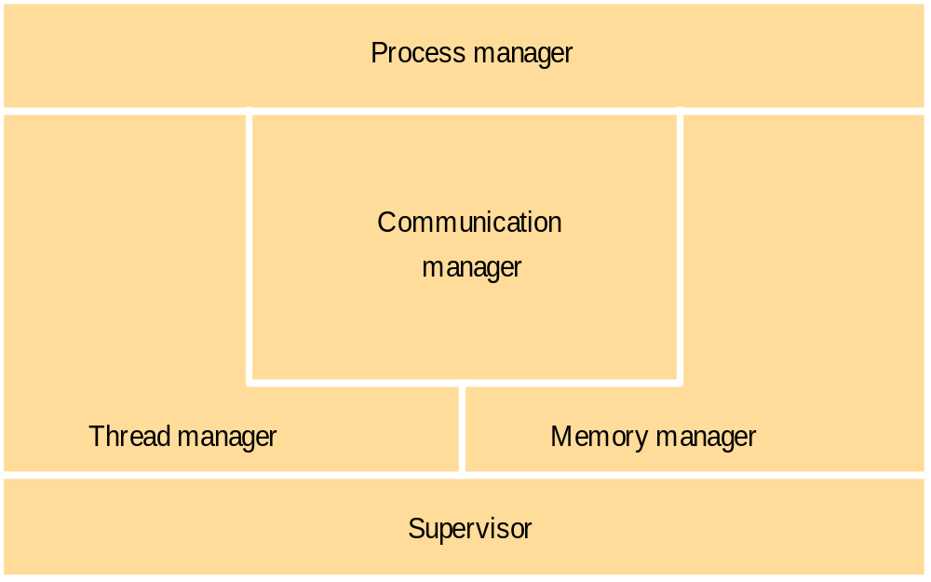
Core OS functionality
*

Slide 14
Processes and Threads
A process consists of an execution environment with one or more threads
  A thread is the operating system abstraction of an activity; execution environment is therefore a collection of local kernel-management resources to which its threads have access; has address space and thread synchronization and communication resources
Address Spaces
  Regions can be shared
    kernel code
    libraries
    shared data & communication
    copy-on-write
  Files can be mapped
    Mach, some versions of UNIX
*

Slide 15
Process address space
2
N
UNIX fork() is expensive
  must copy process's address space
Creation of a new process
  Choice of process host (transfer/location policy; static or adaptive) Load sharing; (central load manager or decentralised); Sender/receiver Initiated algorithms; process migration
Creation of a new execution environment
Auxiliary
regions
Stack
Heap
Text
0
*

Slide 16
Threads versus multiple processes
Creating a thread is (much) cheaper than a process
Switching to a different thread in same process is (much) cheaper (5-50 times)
Threads within same process can share data and other resources more conveniently and efficiently (without copying or messages)
Threads within a process are not protected from each other
*
Notes:
Hidden

Slide 17
Thread life-cycle state-chart diagram
Born
start
Ready
quantum expiration
yield
thread dispatch
(assign a processor)
notify
notifyAll
I/O completes
acquire lock
interrupt
timeout expires
interrupt
Running
enter synchronized statement
wait
sleep
issue I/O request
complete
Waiting
Sleeping
Blocked
sleep interval expires
interrupt
When a thread completes (returns from its run method), it reaches the Dead state
(shown here as the final state)

Slide 18
Threads implementation
Threads can be implemented:
  -in the OS kernel (Win NT, Solaris, Mach)
  -at user level (e.g. by a thread library: C threads, pthreads), or in the language (Ada, Java).
      + lightweight - no system calls
      + modifiable scheduler
      + low cost enables more threads to be employed
  Java can be implemented either way
  hybrid approaches can gain some advantages of both
    user-level hints to kernel scheduler
    hierarchic threads (Solaris)
    event-based (SPIN, FastThreads)
*

Slide 19
Java thread constructor and management methods
Methods of objects that inherit from class Thread
Thread(ThreadGroup group, Runnable target, String name)
  Creates a new thread in the SUSPENDED state, which will belong to group and be identified as name; the thread will execute the run() method of target.
setPriority(int newPriority), getPriority()
  Set and return the thread’s priority.
run()
  A thread executes the run() method of its target object, if it has one, and otherwise its own run() method (Thread implements Runnable).
start()
  Change the state of the thread from SUSPENDED to RUNNABLE.
sleep(int millisecs)
  Cause the thread to enter the SUSPENDED state for the specified time.
yield()
  Enter the READY state and invoke the scheduler.
destroy()
  Destroy the thread.
*
Notes:
Animation: a red box outlines each method in turn

Slide 20
Java thread synchronization calls
thread.join(int millisecs)
  Blocks the calling thread for up to the specified time until thread has terminated.
thread.interrupt()
  Interrupts thread: causes it to return from a blocking method call such as sleep().
object.wait(long millisecs, int nanosecs)
  Blocks the calling thread until a call made to notify() or notifyAll() on object wakes the thread, or the thread is interrupted, or the specified time has elapsed.
object.notify(), object.notifyAll()
  Wakes, respectively, one or all of any threads that have called wait() on object.
synchronized methods (and code blocks) implement the monitor abstraction. The operations within a synchronized method are performed atomically with respect to other synchronized methods of the same object. synchronized should be used for any methods that update the state of an object in a threaded environment.
*

Slide 21
Support for communication and invocation
The performance of RPC and RMI mechanisms is critical for effective distributed systems.
  Typical times for null procedure call very low
  Local procedure call < 1 microseconds
  Remote procedure call ~ 10 milliseconds
  'network time' (involving about 100 bytes transferred, at 100 megabits/sec.) accounts for only .01 millisecond; the remaining delays must be in OS and middleware - latency, not communication time.
Factors affecting RPC/RMI performance
  marshalling/unmarshalling + operation despatch at the server
  thread scheduling and context switching:- including kernel entry
  data copying:- application -> kernel space -> communication buffers
  protocol processing:- for each protocol layer
  network access delays:- connection set-up, network latency
*

Slide 22
Implementation of invocation mechanisms
Most invocation middleware (Corba, Java RMI, HTTP) is implemented over TCP
  For universal availability, unlimited message size and reliable transfer
  Sun RPC (used in NFS) is implemented over both UDP and TCP and generally works faster over UDP
Research-based systems have implemented much more efficient invocation protocols, E.g.
  Firefly RPC (see www.cdk3.net/oss)
  Amoeba's doOperation, getRequest, sendReply primitives (www.cdk3.net/oss)
  LRPC
  Concurrent and asynchronous invocations
  middleware or application doesn't block waiting for reply to each invocation
*

Slide 23
Summary
The OS provides local support for the implementation of distributed applications and middleware:
  Manages and protects system resources (memory, processing, communication)
  Provides relevant local abstractions:
    files, processes
    threads, communication ports
Middleware provides general-purpose distributed abstractions
  RPC, DSM, event notification, streaming
Invocation performance is important
  it can be optimised, E.g. Firefly RPC, LRPC
Microkernel architecture for flexibility
  The KISS principle ('Keep it simple – stupid!')
    has resulted in migration of many functions out of the OS
*

